Slide 1
Convex Hull of a 2D Simple Polyline
Presenter: Yung-Hsing Peng
Date: 2005.12.1

Slide 2
Evolution of finding 2D planar convex hull
Algorithm | Speed | Discovered By
Brute Force | O(n⁴) | [Anon, the dark ages]
Gift Wrapping | O(nh) | [Chand & Kapur, 1970]
Graham Scan | O(n log n) | [Graham, 1972]
Jarvis March | O(nh) | [Jarvis, 1973]
QuickHull | O(nh) | [Eddy, 1977], [Bykat, 1978]
Divide-and-Conquer | O(n log n) | [Preparata & Hong, 1977]
Monotone Chain | O(n log n) | [Andrew, 1979]
Incremental | O(n log n) | [Kallay, 1984]
Marriage-before-Conquest | O(n log h) | [Kirkpatrick & Seidel, 1986]
n: number of points in the input
h: number of points on the output hull

Slide 3
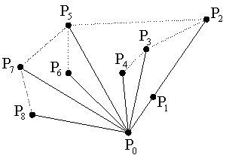
Graham Scan (1/2)
Preprocessing:
Step 1: Find the lowest point P₀
Step 2: Based on P₀, sort other points according its angle with horizontal line
Step 3: Find the first triangle (P₀ P₁ P₂ P₃ for this case)
→ Time complexity for preprocessing is O(nlogn)

Slide 4
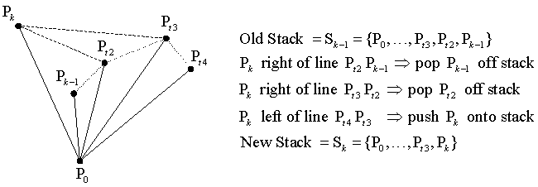
Graham Scan (2/2)
→ Time complexity for scanning is O(n), because we only push and pop for total n elements

Slide 5
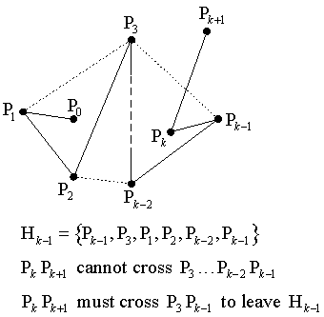
Property of Simple Polyline

Slide 6
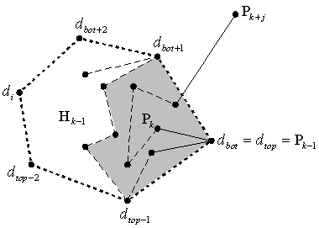
Melkman’s Algorithm (1/2)
If P_{k+j} is in previous hull, then we can pass it and process next point.
If P_{k+j} is on the left side of both d_{top-1}d_{top} and d_{bot}d_{bot+1}, then it must be included in the previous hull, else it will be a point on new hull.
→ Since we can test inclusion in constant time (for simple polyline), then we can skip the preprocessing of sorting.

Slide 7
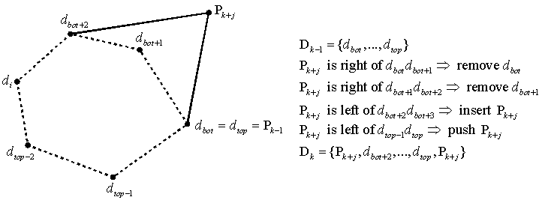
Melkman’s Algorithm (2/2)
If P_{k+j} is exterior to previous hull, then it will become the new top and bottom, after removing some points in dequeue. (note that the top and bottom of D_{k} are both P_{k+j})
→ Since we are pushing and popping for total n elements, it costs O(n) time.

Slide 8
Summary
For simple polyline, Melkman’s algorithm can find the convex hull in O(n) time.
We can transform any 2D planar point set in to a set of simple polyline by sorting the points.
If the input points can be sorted by radix sort, then we can find the convex hull in O(n).
In voronoi diagram, Melkman’s algorithm is easier than Graham scan when constructing the convex hull, since there’s no need to break two hulls into three sequences.

Slide 9
Reference
http://softsurfer.com/algorithm_archive.htm

